Slide 1
Café Chain
Increase your revenue
Anirudh Singh Banirot
Ankit Mohanty
Benny Mathew Kuruvila
Sushma Navada
Tarun Kamal Khiani

Slide 2
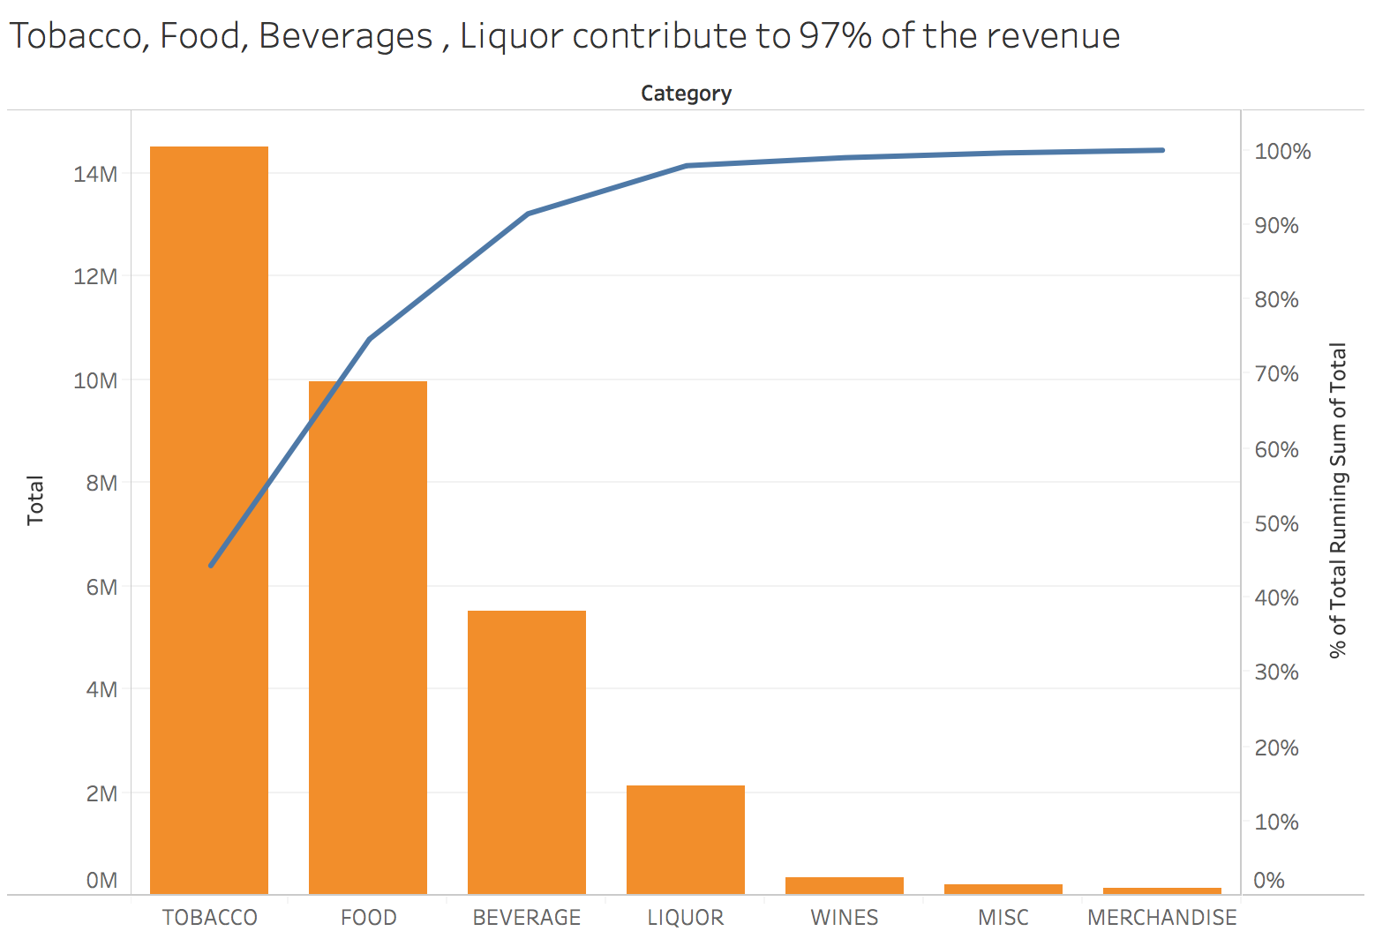
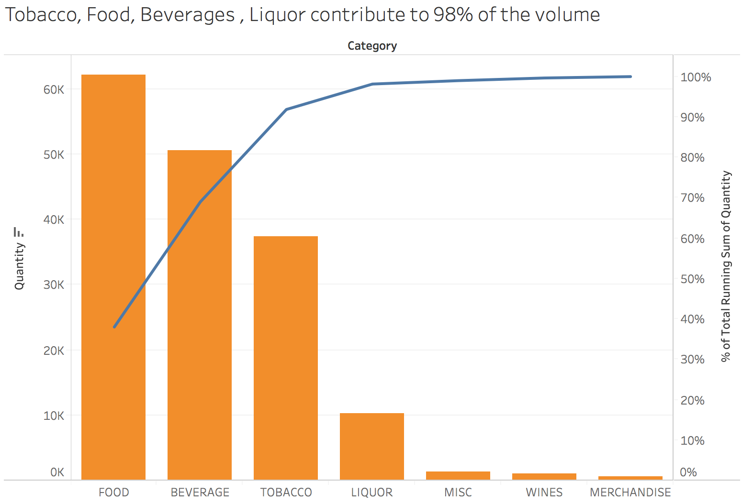
Top categories by revenue & Volume
Tobacco, Food, Beverages & Liquor contribute to majority of the business in terms of both volume & revenue.

Slide 3
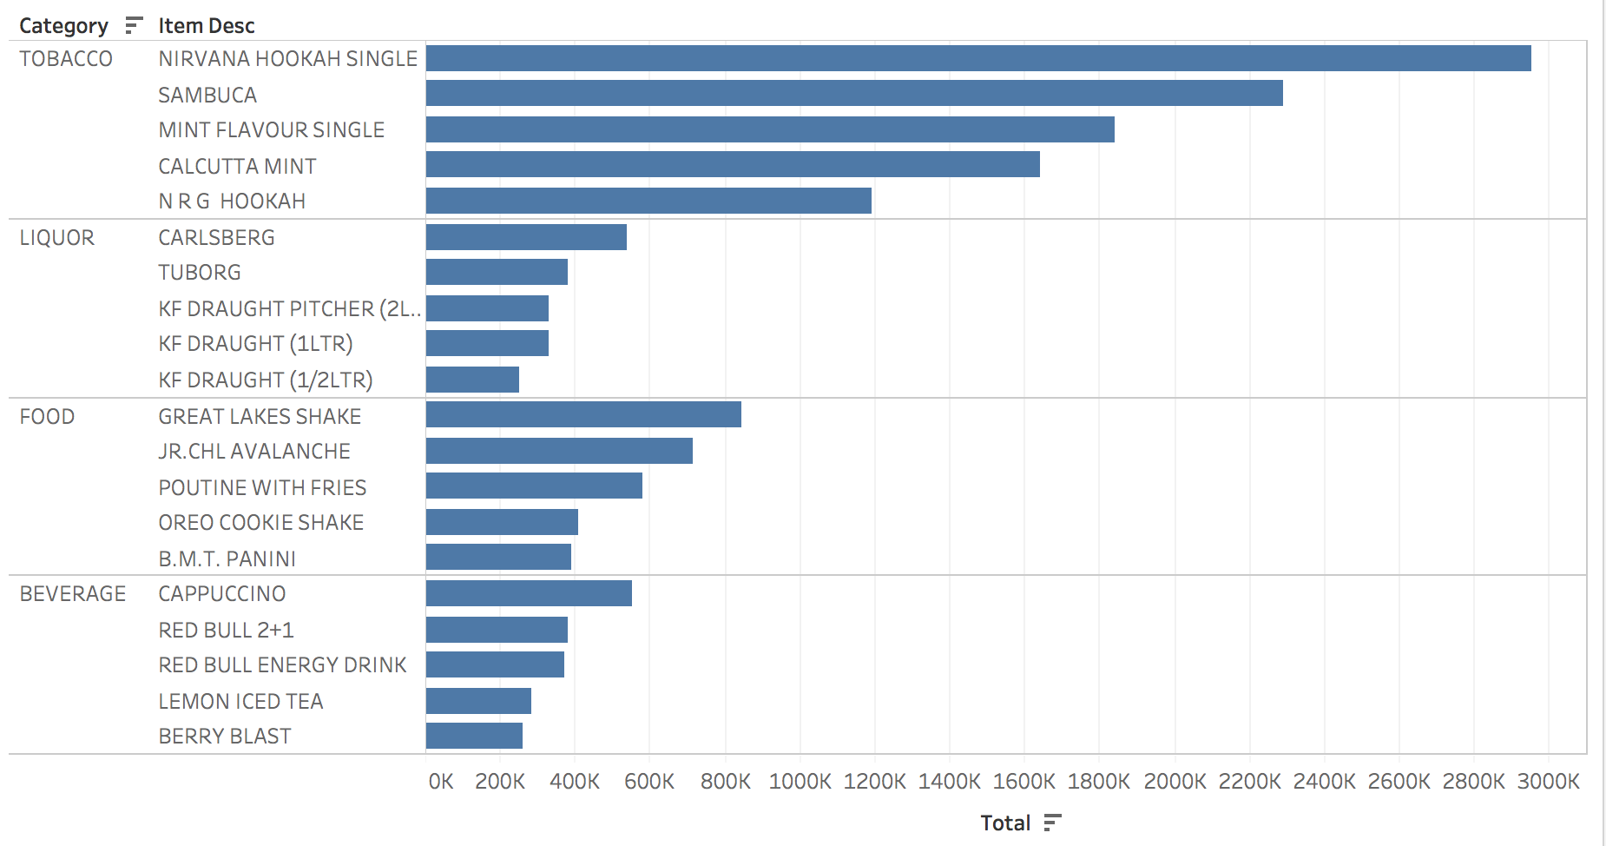
Top 5 Items in Each category

Slide 4
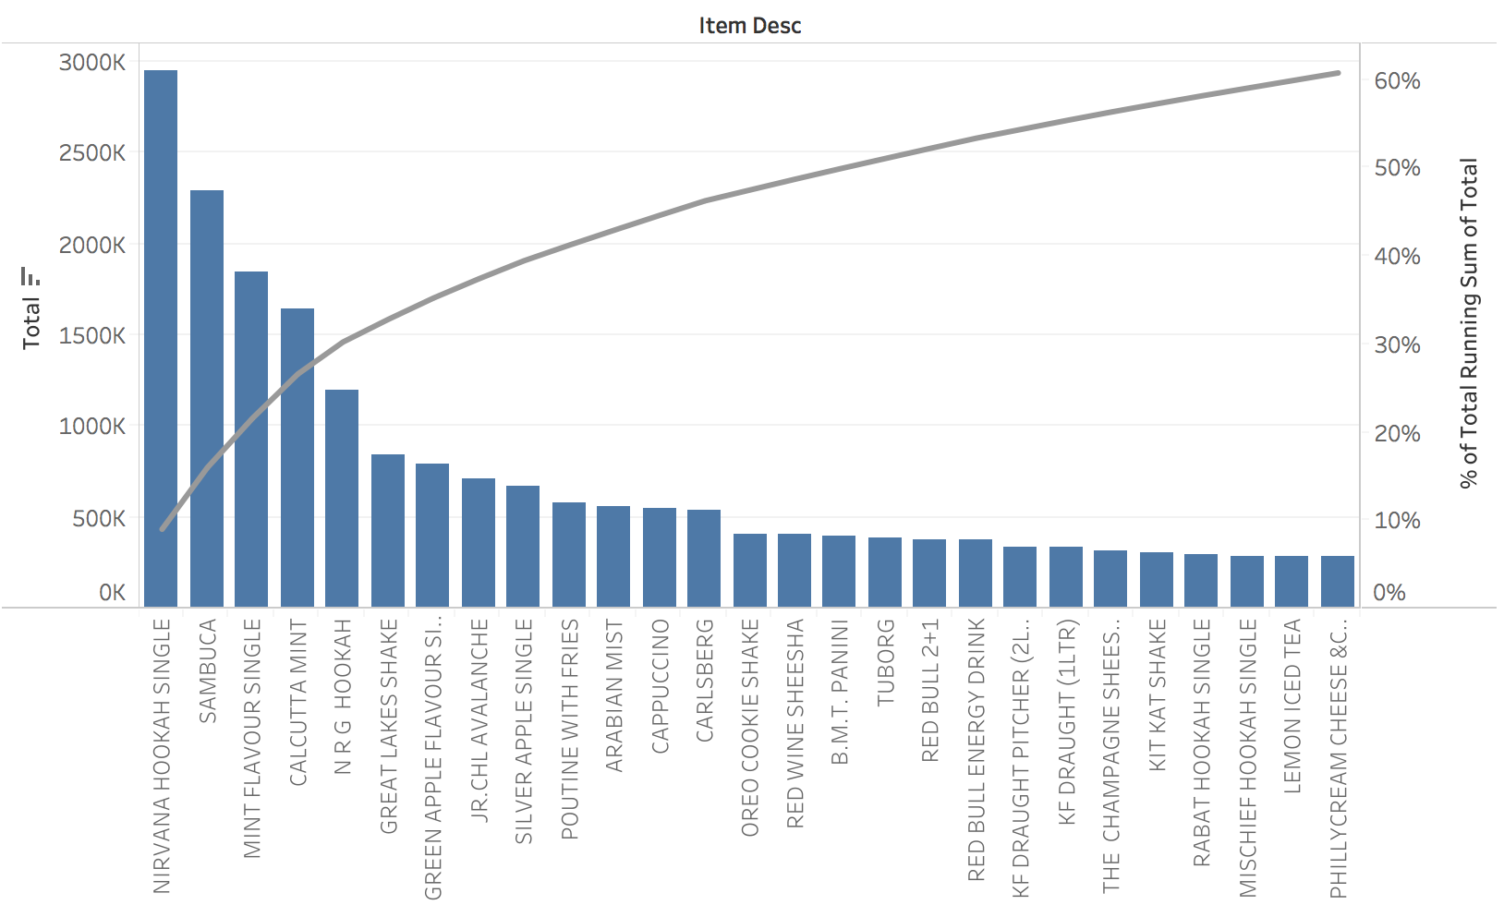
27 Items contribute to 60% of the revenue

Slide 5
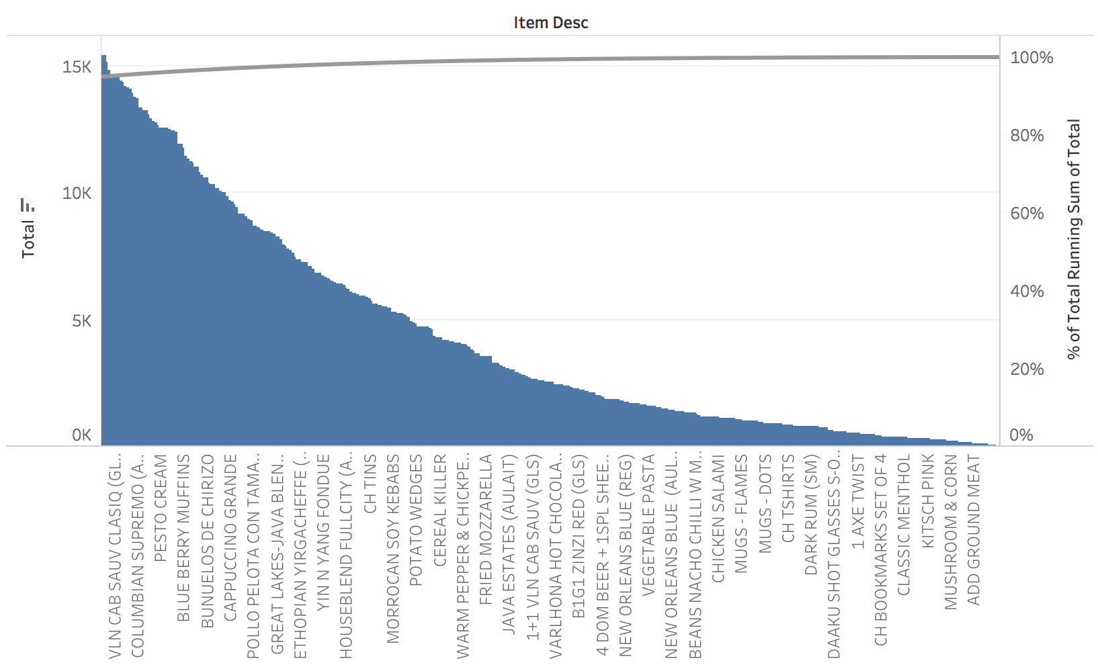
580 Items contribute to less than 5% of the Revenue

Slide 6
List of Bottom 20 items contributing 0-0.01% of the revenue
Items Numbers | Items Description | Items Numbers | Items Description
1 | MOTHERS DAY SPL (FOOD) | 11 | INDIA KINGS OCEAN BLUE (TOBACCO)
2 | ADD BUTTERED TOAST (FOOD) | 12 | ADD GROUND MEAT (MISC)
3 | CUTTING GLASS (MERCHANDISE) | 13 | ADD CHICKEN BACON (MISC)
4 | DIP BOWL (MERCHANDISE) | 14 | GREAT LAKES MUG SINGLE (MERCHANDISE)
5 | MUGS - PLAIN COLOUR (MERCHANDISE) | 15 | COUNTRY LEMONADE GLASS(HANSA) (MERCHANDISE)
6 | MOCAFE HOT CHOCOLATE(SF) (BEVERAGE) | 16 | ASH TRAYS (MERCHANDISE)
7 | GOLD FLAKE ULTRA LIGHTS(20) (TOBACCO) | 17 | 2 AXE TWIST (BEVERAGE)
8 | CH WRAPPING PAPER (MERCHANDISE) | 18 | CH TIN SMALL (MERCHANDISE)
9 | DECAFFINATE COFFEE FRAPPE (BEVERAGE) | 19 | CAPONATA (FOOD)
10 | CLASSIC REGULAR (TOBACCO) | 20 | CLASSIC MENTHOL RUSH (TOBACCO)

Slide 7
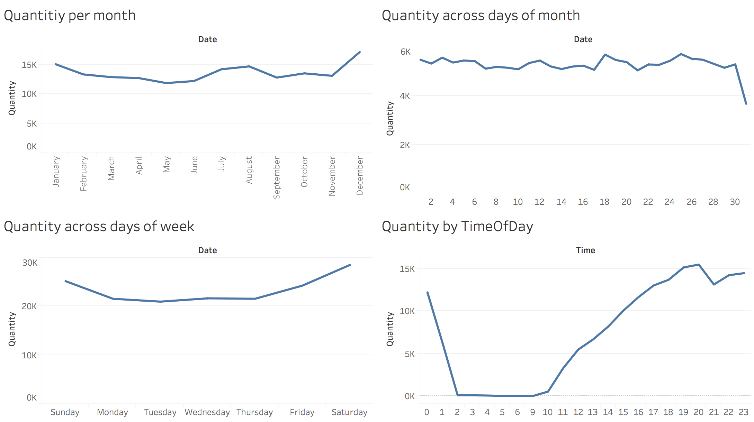
TREND ACROSS time
Volume of business is higher
in Dec, Jan, July & August
on weekends (Friday, Saturday, Sunday)
from 5PM to Midnight
Lower sales are observed towards the end of the month. However Nirvana Hookah, Cappuccino, Great Lakes Shakes, Mint Flavor Single, Sambuca sales have reasonable volume
Low sales in the afternoon 12PM to 4PM & No business from 2AM to 9AM

Slide 8
Offer top selling combos on Weekdays from 12PM to 4PM
Combos | Items in the combo
1 | CAPPUCCINO (BEVERAGE), MINTFLAVOURSINGLE (TOBACCO), POUTINEWITHFRIES (FOOD)
2 | REDBULLENERGYDRINK (BEVERAGE), NIRVANAHOOKAHSINGLE (TOBACCO)
3 | QUAMINERALWATER(1000ML) (BEVERAGE), NIRVANAHOOKAHSINGLE (TOBACCO)
4 | NIRVANAHOOKAHSINGLE (TOBACCO), POUTINEWITHFRIES (FOOD)
5 | CAPPUCCINO (BEVERAGE), GREATLAKESSHAKE (FOOD)
6 | MOROCCANMINTTEA (BEVERAGE), NIRVANAHOOKAHSINGLE (TOBACCO)
7 | JR.CHLAVALANCHE (FOOD), NIRVANAHOOKAHSINGLE (TOBACCO)
8 | REDBULLENERGYDRINK (BEVERAGE), SAMBUCA(TOBACCO)
9 | TUBORG(LIQUOR), CARLSBERG(LIQUOR)

Slide 9
Offer combos on Weekends
Combos | Items in the combo | Rationale
1 | MINTFLAVOURSINGLE (TOBACCO), POUTINEWITHFRIES (FOOD) | Top selling combination
2 | REDBULLENERGYDRINK (BEVERAGE), NIRVANAHOOKAHSINGLE (TOBACCO) | Top selling combination
3 | NIRVANAHOOKAHSINGLE (TOBACCO), POUTINEWITHFRIES (FOOD) | Top selling combination
4 | NIRVANAHOOKAHSINGLE (TOBACCO), GREATLAKEST-SHIRTS (MERCHANDISE) or CHKEYCHAIN (MERCHANDISE) | Top selling tobacco product with a merchandise
5 | TUBORG(LIQUOR), CARLSBERG(LIQUOR), COOLERGLASS(MERCHANDISE) | Top selling liquor with cooler glass as merchandise
6 | B.M.T Panini (FOOD), SAMBUCA(TOBACCO) or NIRVANAHOOKAHSINGLE (TOBACCO) | Top selling tobacco product with food
7 | VLN CAB SAUV (GLS) (WINES), NIRVANAHOOKAHSINGLE (TOBACCO) or POUTINEWITHFRIES (FOOD) | Wine with top selling tobacco product or food
8 | SULA BLUSH ZINFANDEL(GLS) (WINES), NIRVANAHOOKAHSINGLE (TOBACCO) or POUTINEWITHFRIES (FOOD) | Wine with top selling tobacco product or food
9 | RED SANGRIA (CARAFE) (WINES), B.M.T Panini (FOOD) or SAMBUCA(TOBACCO) | Wine with top selling tobacco product or food
10 | VLN CHENIN BLANC (GLS) (WINES) B.M.T Panini (FOOD) or SAMBUCA(TOBACCO) | Wine with top selling tobacco product or food
11 | VLN CAB SAUV (GLS) (WINES), TUBORG(LIQUOR) or CARLSBERG(LIQUOR) | Wine with top selling liquor

Slide 10
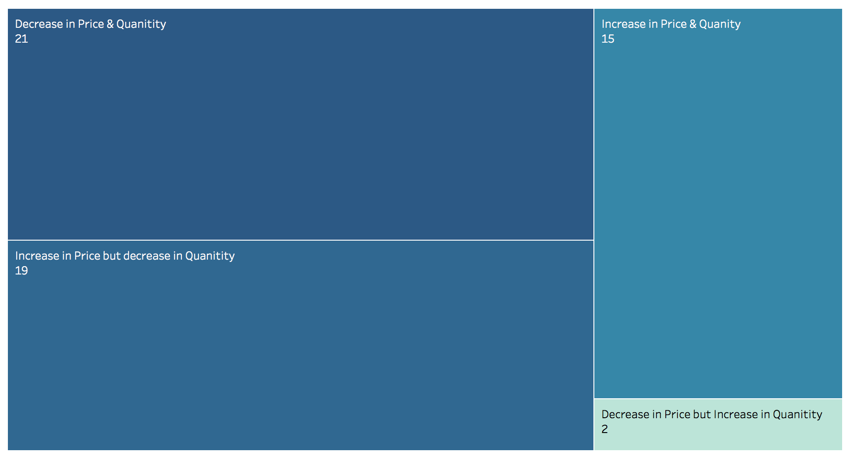
Affect of Price changes

Slide 11
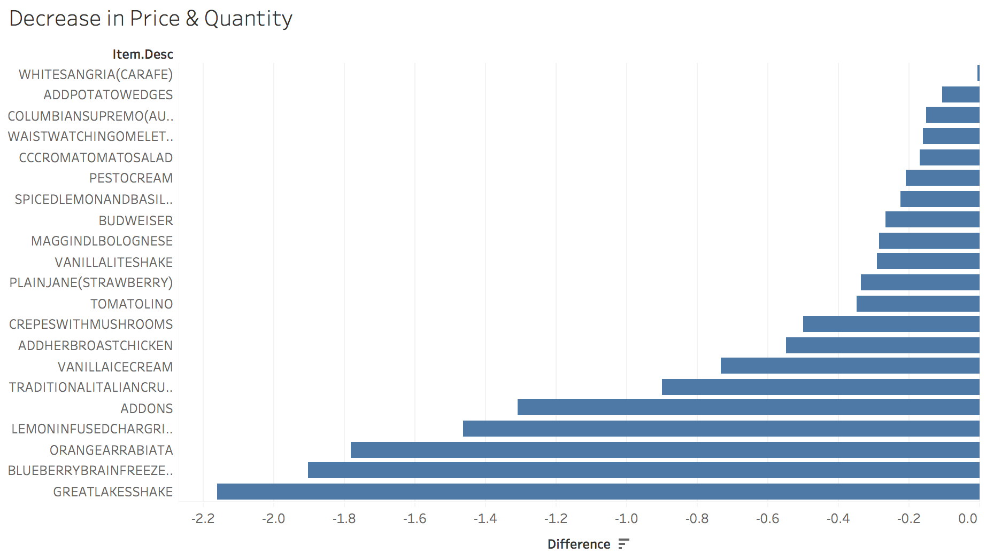
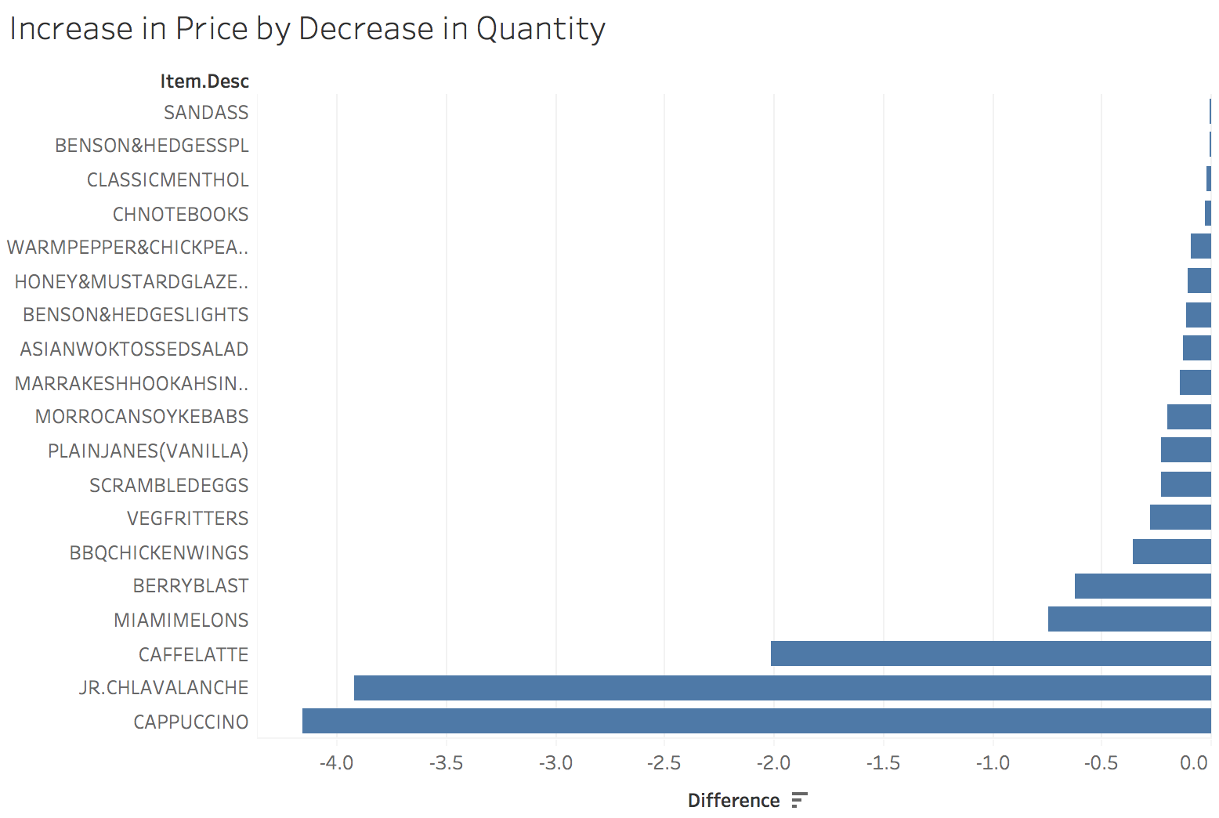
Negative affect of Price Changes

Slide 12
Recommendations to increase revenue
Discontinue items which contribute to less than 5% of the revenue
Revise prices of 40 items where quantity sold has reduced either due to a decrease/increase in price
Offer promotions on weekdays (Monday to Thursday)
Offer top selling combos on Weekdays from 12PM to 4PM
Offer combos on Weekends
A few top selling combos
Tobacco – Wine
Tobacco – Merchandise

